Slide 1

Exponential Smoothing
By: Eric Wisniewski

Slide 2

What Is Exponential Smoothing?
Exponential smoothing is a time series forecasting method for univariate data that can be extended to support data with a systematic trend or seasonal component.

Slide 3
Pros:
Simpler to understand and explain
Widely accepted and used
Often most accurate
Adaptive (as data changes, good at capturing changes and using current conditions)
Robust (Smoothing is great for rough data)
Easy to apply
Can be automated

Slide 4
Cons:
Is a time series model (based on past history)
Does not capture non calendar-based events (e.g. stocks)
Does not allow introduction of explanatory variables (prices at times)
Implementations vary and some are poor

Slide 5

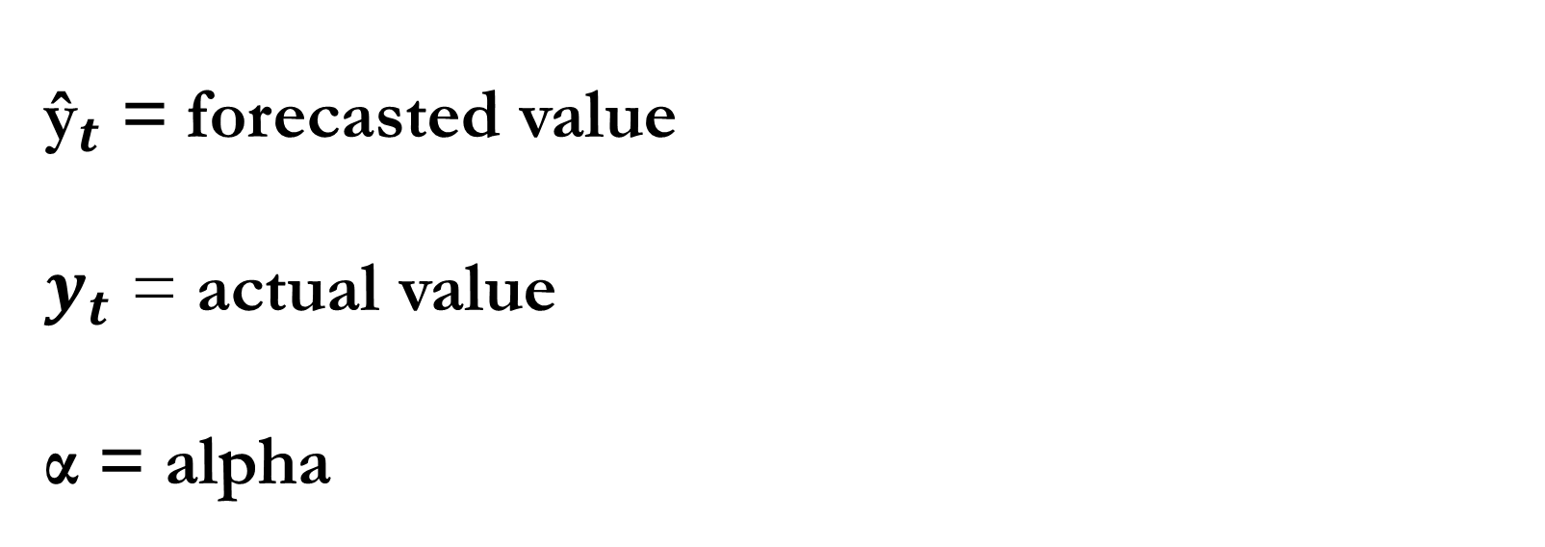
Standard (Simple) Formula
${\text{ŷ}}_{t}$+1 = ${\text{ŷ}}_{t}$ + α($y_{t}$- ${\text{ŷ}}_{t}$)
${\text{ŷ}}_{t}$ = forecasted value
$y_{t}$ = actual value
α = alpha

Slide 6

${\text{ŷ}}_{t}$+1 = ${\text{ŷ}}_{t}$ + α($y_{t}$- ${\text{ŷ}}_{t}$)
Notes on α:
When values are closer to zero, it causes data to rely less on the difference of past actual values and predicted values. Past values are more import to data. More historic values are emphasized.
When values are closer to one, it causes data to rely more on recent data, e.g. previous year, as opposed to data that is more historic. Past values are not as important. More recent values are emphasized.
There are automized functions within many coding libraries (e.g. Python, Excel) that find the most optimal value for alpha. In Microsoft Excel, when doing exponential smoothing, it only asks what values need to be used and the dampening factor. The dampening value can not be applied to the simple formula, only to Holt & Holt-Winters.

Slide 7
Models
There are many types of exponential smoothing methods used by forecasters for different scenarios. The three main models used by these forecasters are the simple model, Holt’s Model, and the Holt-Winter’s model.

Slide 8
Components
Level
Trend
Seasonality

Slide 9

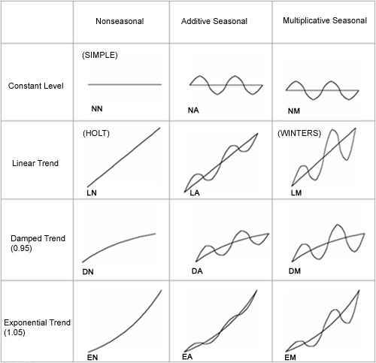
Simple:
Method for univariate data without a linear or seasonal trend.
Only alpha is smoothing the level
Holt:
Adds support of trends within the model.
Uses alpha for level smoothing, and beta for trend smoothing
Trend dampens over time and levels out. Unrealistic for long range forecasts.
Holt-Winters:
Adds gamma, to smooth seasonal component.
Also requires a period, range of time, for forecasting
Most advanced model of exponential smoothing.

Slide 10

